Slide 1
面向服务的编程模型
服务组件架构SCA(Service Component Architecture)
服务数据对象SDO(Service Data Object)

Slide 2
为了促进面向服务应用的开发，IT公司联合起来，在2005年11月发布了服务组件架构和服务数据对象规范，这些公司包括IBM，BEA，Oracle，SAP等。
SCA的目标是大大简化服务开发，直接采用web服务和XML开发服务。其中，SCA定义和规范了技术中立和实现透明的服务组件、服务及服务调用和组装；
SDO定义和规范了服务世界里的数据，这些数据对象拥有清晰定义的信息模型，独立于数据源和具体数据访问技术，使得服务访问数据和在服务间交换数据更方便有效。
很多公司已在JEE平台上支持了SCA/SDO，还提供了C++的版本。IBM WebSphere process Server 6实现了SCA/SDO规范，提供了最新的SAO编程模型的支持，已经在很多实践中被广泛使用。

Slide 3
Introduction to SCA

Slide 4
Agenda
SCA: Why?
SCA Fundamentals

Slide 5
SCA: Why?
Business Drivers
What we have today
Where do we want to go
SOA core Elements

Slide 6
Business Drivers
Flexible businesses require flexible IT
  Globalization demands greater flexibility
  Business processes:daily changes vs. yearly changes
  Crucial for flexibility and becoming an On Demand Business

Slide 7
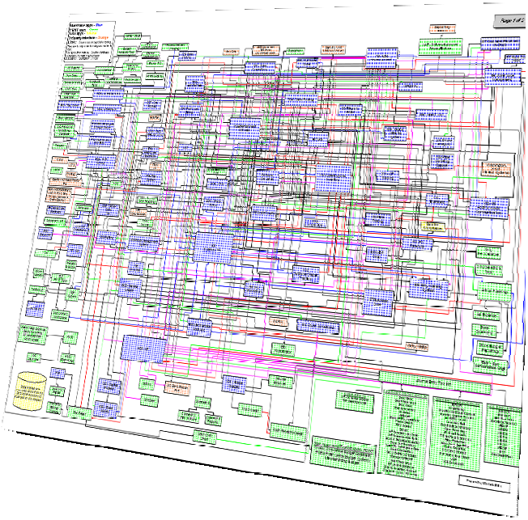
What We have Today
Complexity
Rigid, brittle architectures
Inability to evolve

Slide 8
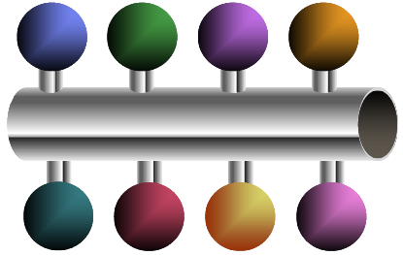
Where do we want to go?
Well-defined interfaces with business-level semantics
Standardized communication protocols
Flexible recombination of services to enhance software flexibility

Slide 9
SCA Fundamentals
The SCA specifications define how to create components and how to combine those components into complete applications.
SCA core concepts
  Component
  Composite
  Domain
Notes:
Now owned by OASIS, SCA was originally created by a group of vendors, including BEA, IBM, Oracle, SAP, and others. The SCA specifications define how to create components and how to combine those components into complete applications. The components in an SCA application might be built with Java or other languages using SCA-defined programming models, or they might be built using other technologies, such as the Business Process Execution Language (BPEL) or the Spring Framework. Whatever component technology is used, SCA defines a common assembly mechanism to specify how those components are combined into applications.

Slide 10
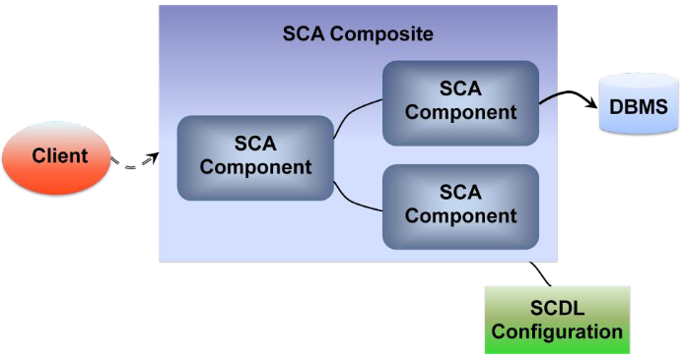
Component and Composite
Notes:
Every SCA application is built from one or more components. In a simple application, the components could be Java classes running in a single process, and their interactions might rely on Java interfaces exposed by those classes. In a slightly more complex case, the Java classes in this application might be running on different machines, relying on some communication mechanism to interact with one another. In a still more complex case, the application might contain a few components implemented as Java classes, others written in C++, and still others defined using BPEL, all spread across a group of machines. In all of these situations, the same fundamental issues exist: There must be a way to define components and to describe how they interact. And in an increasingly service-oriented world, those interactions should be modeled as services, cleanly separating the implementation technology from the function that’s provided. To do this, SCA defines a generalized notion of a component. It also specifies how those components can be combined into larger structures called composites. The figure below shows how a simple composite built from three SCA components might look.
A composite is a logical construct: Its components can run in a single process on a single computer or be distributed across multiple processes on multiple computers. A complete application might be constructed from just one composite, as in the example shown here, or it could combine several different composites. The components making up each composite might all use the same technology, or they might be built using different technologies—either option is possible.
As the figure shows, an SCA application can be accessed by software from the non-SCA world, such as a JavaServer Page (JSP), a Web services client, or anything else. Components in an SCA application can also access data, just like any other application. One option for this is to use Service Data Objects (SDO), perhaps in concert with a standard Java data access technology such as JDBC or Java EE 5’s Java Persistence API (JPA). An SCA component can also use JDBC, JPA, or something else directly—the SCA specifications don’t mandate any particular choice.

Slide 11
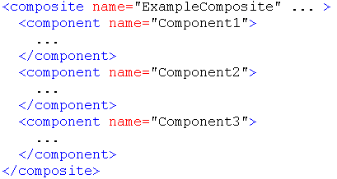
Service Component Definition Language (SCDL)
Notes:
An SCA composite is typically described in an associated configuration file, the name of which ends in .composite. This file uses an XML-based format called the Service Component Definition Language (SCDL, commonly pronounced “skiddle”) to describe the components this composite contains and specify how they relate to one another. For the three-component composite shown above, the basic structure of its SCDL configuration would look like this:

Slide 12
Domain
Components and composites are the fundamental elements of every SCA application. Both are contained within a larger construct called a domain.
A domain can contain one or more composites, each of which has components implemented in one or more processes running on one or more machines.
Notes:
An implicit assumption of SCA’s creators was that a given environment would install a group of SCA products, commonly known as runtimes, from a single vendor. For example, suppose a division of a large firm chooses a particular company as its SCA vendor. This division is likely to install their chosen vendor’s SCA runtime on a number of machines. This isn’t an unreasonable expectation, as it mirrors how organizations have typically purchased and installed JEE products. These SCA runtimes will likely be managed by the same group of people, and this set of systems—with a common vendor’s runtime technology and common management—provides the primary example of a domain.

Slide 13
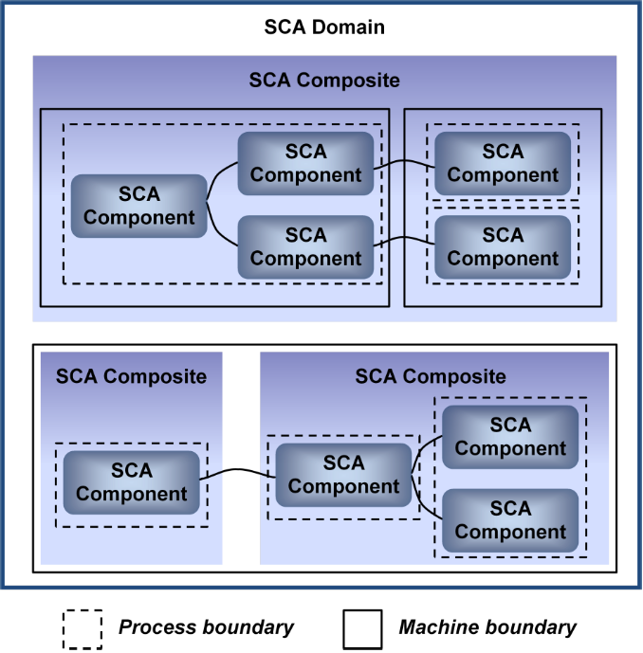
Domain
Notes:
the figure below shows an example of how this might look.
The domain shown here contains three composites and three computers. One composite, shown in the upper part of the figure, consists of five components spread across three processes in two different machines. The other two composites, shown in the lower part of the figure, run all of their components on a single machine, dividing them into three separate processes. How communication happens between these components, whether it’s intra-process, inter-process, or inter-machine, can be defined differently by each SCA vendor. Whatever choice is made, composites don’t span domain boundaries.
It might seem odd for a multi-vendor specification to define a way to create distributed applications, yet not define how the components in those applications interact. To understand this, realize that the primary goal of SCA’s creators was to allow portability of code and developer skills across different SCA implementations. While creating composites that span domains—and thus vendor boundaries—might one day be possible, this wasn’t a goal for the first version of SCA. Also, limiting composites to a single domain allows useful optimizations. An SCA developer’s life is significantly simpler inside a domain, for example, since the complexities inherent in configuring multi-vendor applications can be avoided.

Slide 14
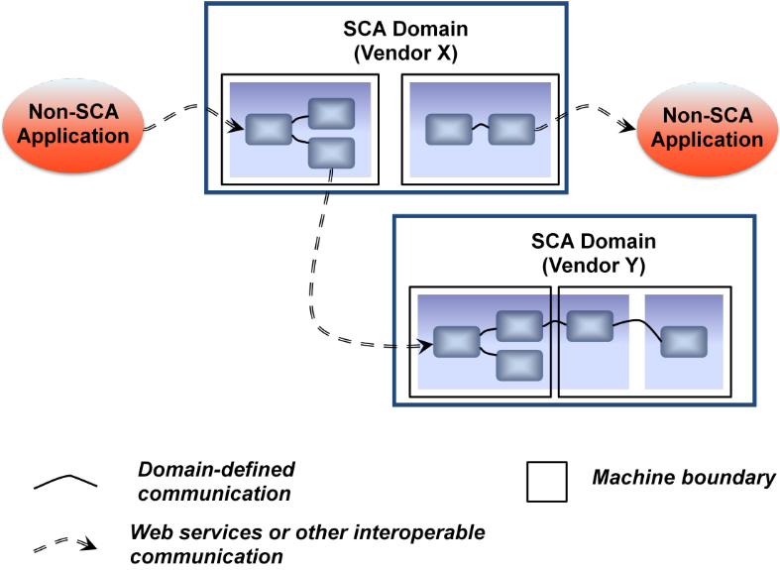
Communication across Domain
Notes:
Even though an SCA composite runs in a single-vendor environment, it can still communicate with applications outside its own domain. To do this, an SCA component can make itself accessible using an interoperable protocol such as Web services. The figure below shows how this looks.
This example shows two SCA domains, each with two computers. One domain uses vendor X’s SCA runtime, while the other uses vendor Y’s SCA runtime. All of the communication between components and composites within each domain is done in a vendor-specific way—SCA doesn’t mandate how this interaction should happen. To communicate between domains, however, or with non-SCA applications, a component will typically allow access via Web services or some other interoperable mechanism. In fact, an SCA application communicating with another SCA application in a different domain sees that application just like a non-SCA application; its use of SCA isn’t visible outside its domain.

Slide 15
Understanding Components
Components are the atoms from which an SCA application is created
SCA components behave in consistent ways, and they can be assembled into different configurations
Notes:
In the parlance of SCA, a component is an instance of an implementation that has been appropriately configured. The implementation is the code that actually provides the component’s functions, such as a Java class or a BPEL process. The configuration, expressed in SCDL, defines how that component interacts with the outside world. In theory, an SCA component could be implemented using pretty much any technology. Yet whatever technology is used, every component relies on a common set of abstractions, including services, references, properties, and bindings, to specify its interactions with the world outside itself. This section describes each of these.

Slide 16
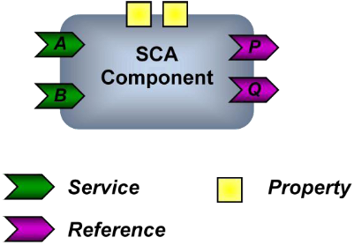
Understanding Components
Service
Reference
Property
Notes:
Looked at from the outside, an SCA component is a simple thing. Whatever technology is used to create it, every component has the same fundamental parts, as shown below.
Each component typically implements some business logic, exposed as one or more services. A service, represented by a green chevron in the figure, provides some number of operations that can be accessed by the component’s client. How services are described depends on the technology that’s used to implement the component. A Java component, for example, might describe its services using ordinary Java interfaces, while a component implemented in BPEL would likely describe its services using the Web Services Description Language (WSDL).
Along with providing services to its own clients, a component might also rely on services provided by other components in its domain or by software outside its domain. To describe this, a component can indicate the services it relies on using references. Shown as a purple chevron in the figure above, each reference defines an interface containing operations that this component needs to invoke.
Along with services and references, a component can also define one or more properties. Each property contains a value that can be read by that component from the SCDL configuration file when it’s instantiated. For example, a component might rely on a property to tell it what part of the world it’s running in, letting it customize its behavior appropriately.

Slide 17
Understanding Components
Service: externally accessible software functionality of an implementation
Reference: dependency on an external service
Property: allow for the configuration of an implementation with externally set data values

Slide 18
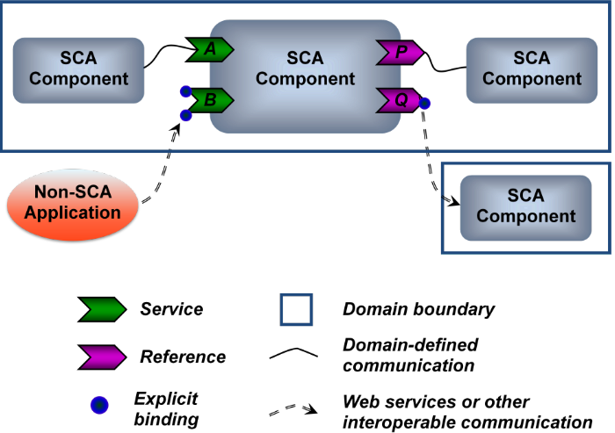
Understanding Components
Binding
  Services and references let a component communicate with other software. By design, however, they say nothing about how that communication happens. Specifying this is the job of bindings.
Notes:
A binding specifies exactly how communication should be done between an SCA component and something else. Depending on what it’s communicating with, a component might or might not have explicitly specified bindings. As the figure shows, a component that communicates with another component in the same domain, even one in another process or on another machine, need not have any explicit bindings specified. Instead, the runtime determines what bindings to use, freeing the developer from this chore.
To communicate outside its domain, however, whether to a non-SCA application or an SCA application running in some other domain, a component’s creator (or perhaps the person who deploys the component) must specify one or more bindings for this communication. Each binding defines a particular protocol that can be used to communicate with this service or reference. A single service or reference can have multiple bindings, allowing different remote software to communicate with it in different ways.
Because bindings separate how a component communicates from what it does, they let the component’s business logic be largely divorced from the details of communication. This is a departure from the approach taken by older technologies, which tended to mix the two. Separating these independent concerns can make life simpler for application designers and developers.

Slide 19
An Example: SCA’s Java Component Model
Defining Services
Defining References
Defining Properties
Defining Bindings

Slide 20
Defining Services: Interface
import org.osoa.sca.annotations.Remotable;
public interface AddService {
double add(double n1, double n2);
}
public interface SubtractService {
double subtract(double n1, double n2);
}
@Remotable
public interface CalculatorService {
double add(double n1, double n2);
double subtract(double n1, double n2);
String getName();
}
Notes:
This example begins by importing an annotation definition from a standard SCA package. It then uses this annotation, @Remotable, to indicate that the service provided by the CalculatorService interface can be made accessible to remote clients. While there’s a bit more that needs to be defined for this component in the SCDL configuration, as described later, this annotation is all that’s required in the Java code. The SCA runtime does everything required to make the service accessible to remote clients. For clients in the same SCA domain as this service, the wire protocol used for communication isn’t mandated—each SCA runtime can use whatever it likes. Still, to allow cross-vendor interoperability, all remotable interfaces must be expressible in WSDL, which means they can potentially be accessed via SOAP.

Slide 21
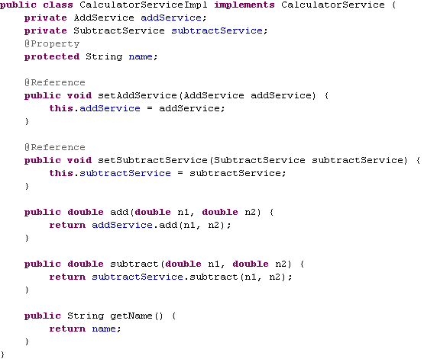
Defining Services(2)

Slide 22
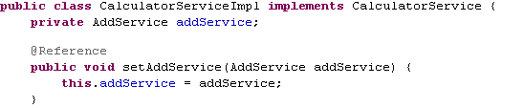
Defining References
Notes:
Yet the component never needs to create an instance of a class that implements the AddService interface. Instead, the runtime automatically locates a component that provides this interface, then sets the value of addService to point to that service. Rather than relying on the developer to write code that finds the service, this responsibility is passed to the runtime.

Slide 23

Defining Properties
Notes:
Like references and remote services, properties are identified using an annotation: @Property. This annotation can be assigned to a field in a Java class or to a setter method, and in either case, it indicates that a value should be read from the SCDL configuration file of the composite to which this component belongs. Properties can also be more complex—they needn’t be just single-valued strings or integers or other simple types. Whether they’re simple or complex, however, the goal is the same: providing a way to configure a component via values that are read at runtime.

Slide 24
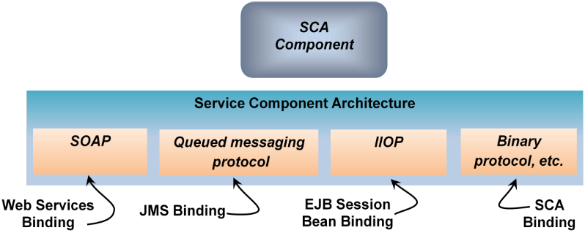
Defining Bindings
Notes:
As described earlier, bindings determine how a component communicates with the world outside its domain. Bindings can be assigned to services and to references, and each one specifies a particular protocol. To illustrate why bindings are useful, think of how applications use different protocols in Java EE5 and its J2EE predecessors. As shown below, each protocol is provided by a distinct technology, so each one has its own application programming interface. Using SOAP over HTTP, for example, typically means building on JAX-WS (or JAX-RPC in J2EE 1.4), while using a queued messaging protocol requires the Java Message Service (JMS). This forces developers to learn different APIs, perhaps with entirely different programming models, to use different protocols. It also mixes business logic with communication code, further complicating a developer’s life.
SCA takes a simpler approach. Rather than wrapping different protocols into distinct technologies with different APIs, SCA allows each remotable service and each reference to specify the protocols it supports using bindings. The programming model seen by an application remains the same regardless of which protocol is used, as the figure below illustrates.
To be accessible via SOAP over HTTP, for example, an SCA service uses the Web Services binding, while access via a queued messaging protocol uses the JMS binding. Similarly, the EJB session bean binding allows access to session beans using the Internet Inter-ORB Protocol (IIOP). Every SCA runtime also provides an SCA binding. The protocol this binding uses isn’t specified, however. Instead, the SCA binding is only used when a service and its client are both running in the same domain. Since every vendor wants applications built on its products to perform as well as possible, it’s safe to assume that this binding will most often use a binary protocol. This isn’t required, however; an SCA runtime is free to choose different protocols in different situations, all of which fall under the umbrella of the SCA binding.

Slide 25
Configuring a Component
<component name="CalculatorServiceComponent">
<implementation.java class=“xmu.calculator.CalculatorServiceImpl"/>
<reference name="addService" target="AddServiceComponent" />
<reference name="subtractService" target="SubtractServiceComponent" />
<property name="name">My Calculator</property>
<service name="CalculatorService">
<interface.java interface=“xmu.calculator.CalculatorService"/>
<binding.ws/>
</service>
</component>
<component name="AddServiceComponent">
<implementation.java class=“xmu.calculator.AddServiceImpl"/>
</component>
<component name="SubtractServiceComponent">
<implementation.java class=“xmu.calculator.SubtractServiceImpl"/>
</component>
</composite>
Notes:
详细内容请参考实验文档

Slide 26
Understanding Composite
Composites group components into useful combinations, which can themselves be further combined.
Notes:
If components are the atoms of SCA, then composites are the molecules. Composites group components into useful combinations, which can themselves be further combined. This building-block approach to creating applications has some obvious pluses. For example, providing a well-defined set of abstractions for components can help people who create applications think more clearly about how those applications should be designed. Keeping these abstractions consistent across different technologies also makes building applications using different languages and runtimes easier. Recall, too, that the components in a composite might run in the same process, in different processes on a single machine, or in different processes on different machines. In all of these cases, it’s useful to have some way to deploy the entire application as a unit. And since components provide discrete, well-defined services, a graphical tool could allow assembling or re-assembling various components as needed to address a particular problem. Doing this can make a developer’s life easier, and it might even allow less technically adept people to create applications by assembling existing components.
Achieving these goals requires defining how components relate to one another within a composite, relationships described in SCA’s assembly model specification. This section takes a closer look at how an SCA composite is assembled.

Slide 27
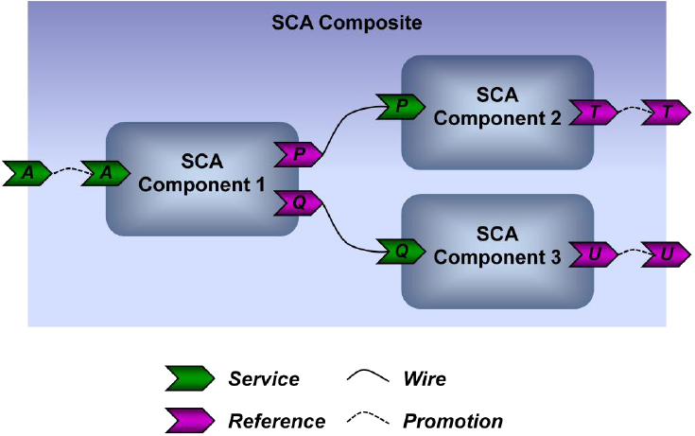
Wires and Promotion
Notes:
The figure below shows three components, each with some combination of services and references. All three are part of the same composite.
As the figure shows, a reference in one component is connected to a service in another component using a wire. A wire is an abstract representation of the relationship between a reference and some service that meets the needs of that reference. Exactly what kind of communication a wire provides can vary—it depends on the specific runtime that’s used, what bindings are specified (if any), and other things. And since the components in a composite might run entirely within a single process, across processes on a single machine, or be spread across processes on different machines, wires can represent relationships in all of these cases.
Just as components expose services, a composite can also expose one or more services. These services are actually implemented by components within the composite. To make them visible to the outside world, the composite’s creator can promote those services. In this example, service A implemented by Component 1 is promoted to be a service provided by the composite itself. Similarly, zero, one, or more references defined by components can be promoted to be visible outside the composite. Here, both references T and U are promoted to the composite level.

Slide 28
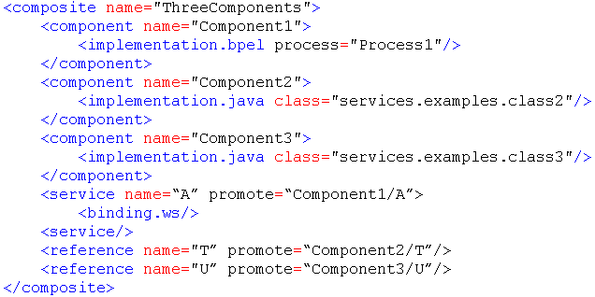
Configuring a Composite
Notes:
All of the relationships in a composite are expressed in the SCDL configuration file. Here’s a slightly simplified example of how this file might look for the scenario shown above:

Slide 29
SCA Runtime
The SCA specs say essentially nothing about how this technology should be implemented. Various open source implementations exist, including Tuscany and Fabric3, while several vendors are creating their own implementations.

Slide 30
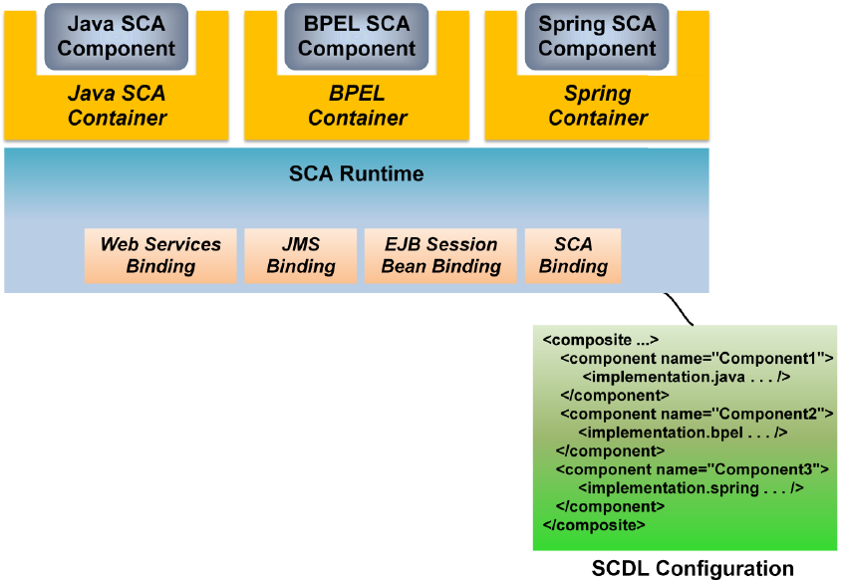
SCA Runtime
Notes:
As shown here, an SCA runtime might provide a number of containers, one for each component technology it supports. The SCDL configuration file’s implementation element tells the runtime both what kinds of containers it needs for a particular composite and where to find the implementations of the components in that composite. In this example, for instance, the SCDL configuration file specifies that containers implementing SCA’s Java component model, BPEL, and Spring are required. The SCA runtime provides all bindings, allowing components created using any technology to use any available binding. The runtime also defines all communication between components, regardless of how those components are implemented.
Although it’s not required, an SCA implementer can make public the interface between its runtime and containers. Doing this allows third parties to create their own containers, making the SCA runtime more extensible. One option for this interface is Java Business Integration (JBI), a specification created under the Java Community Process. JBI supports only Java-based technologies, however—using it for, say, a C++ container would be problematic—and it hasn’t received wide support from the major Java vendors. While some SCA vendors might choose to use it, neither Tuscany nor Fabric3 implement JBI.
It’s also possible for the creator of an SCA runtime to use OSGi. Created by a multi-vendor working group, this specification has received significantly more support from the major SCA vendors than has JBI. OSGi defines how to package code into bundles, and while it’s also Java-only, some creators of SCA runtimes might allow extensions such as a new binding to be added as an OSGi bundle.
Runtimes and containers are certainly necessary, but so are tools for developers. SCA tools are being provided by various vendors, and there’s also an open source tooling project underway. Known as the SOA Tools Platform Project, one of its goals is to create SCA-based development tools for Eclipse. As with 22
many technologies, a significant number of developers will see SCA largely through the lens of whatever tool they adopt.

Slide 31
Reference
http://tuscany.apache.org/sca-overview.html
http://tuscany.apache.org/quick-guide-to-sca.html

Slide 32
SDO: Service Data Objects
An Overview

Slide 33
Agenda
The Big Picture
Key Concepts and Core APIs
Apache Tuscany SDO and DAS

Slide 34
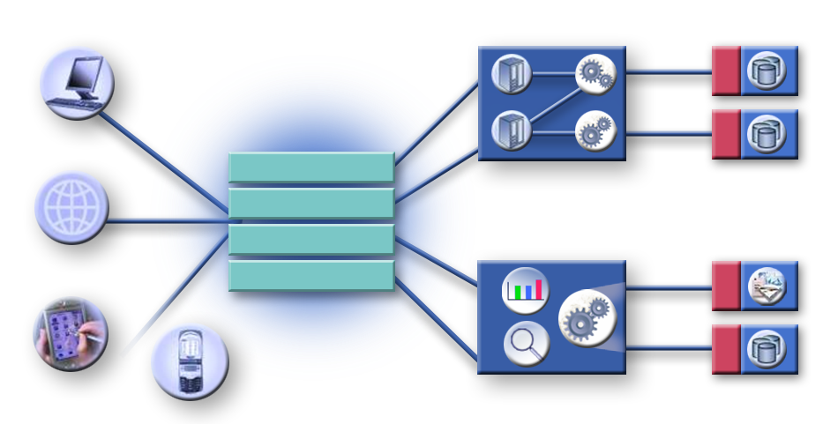
Information as a Service
Business Processes
SDO
Rich client
SDO
SDO
Business Applications
Monitoring
Workflows
Application Adapters
Portals
Composite Applications
Information Services
Browser
Workflows
SDO
Mobile
Clients
Analysis
Quality
Integration
Data & Content
Notes:
SDO provides a set of capabilities for handling business data in a form that is independent of the source or the target of the data. Handling data is key to any business application, but in solutions using SOA, data may have a range of underlying formats. There is data held in relational databases (RDB), and there is data in XML format transmitted via Web services, for example.

Slide 35
SDO is Used Everywhere
Service Oriented Architecture (SOA)
  SDOs are the input and output of services
Web Services
  SDOs represent the XML on the wire
XML
  When XML-enabling an application
  When accessing XML files/documents/resources/messages
EJB
  SDOs are Data Transfer Objects (DTO), value objects
  J2EE Design Pattern
Enterprise Service Bus (ESB)
  SDOs are the input and output of services
Model Driven Architecture (MDA)
  SDO model (Type and Property) defined by Unified Modeling Language (UML) Classes and Components
  SDO applications follow UML Sequence, Flow, State, and Collaboration
Data access
  Access relational, XML, EJB, JDO, Hibernate data sources
  SDOs are the DTOs
Messaging
  SDOs represent the messages
Connectors/Adapters (EIS, CICS)
  SDOs represent the data records
BPEL-J
  SDOs are the Java business objects
ADO.NET
  DataSet is a subset of SDO Data Graphs
Cross-language programming model
  Complete applications may span tiers, languages
Java
  SDOs are smart POJOs with POJO interfaces

Slide 36
SOA and SDO
Other Apps
Modules
SDO
SCA
CustomerInfo
Other Apps
Modules
SDO
SDO
Web
Export
SCA
MyValue
MyValue
SDO
SDO
Import
Web
StockQuote
MyValueModule
SOA (SCA) is the component model
Components may be wired together
SDO DataObjects are the data flowing on wires between Components

Slide 37
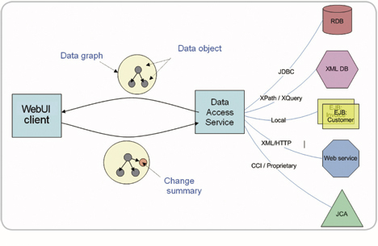
Heterogeneous Data Access
Notes:
SDO provides flexible data structures that allow data to be organized as graphs of objects (called data objects) that are composed of properties. Properties can be single or many valued and can have other data objects as their values. A data object can maintain a change summary of the alterations made to it, providing efficient communication of changes and a convenient way to update an original data source. SDO naturally permits disconnected data access patterns with an optimistic concurrency control model.
SDO offers a convenient way to work with XML documents. SDO implementations provide helpers to populate a data graph from both XML documents and relational databases and to read SDO metadata from an XML Schema Definition (XSD). Data objects can be serialized to XML and the metadata can be serialized to an XSD file
Data Objects can be introspected using the SDO metadata API to get information about types, relationships, and constraints.
SDO delivers unified and consistent access to data from heterogeneous sources. This provides both a simple programming model for the application programmer and lets tools and frameworks work consistently across those heterogeneous data sources.
SDO offers a single model for data across the enterprise.
The diagram below shows a WebUI client accessing data from a variety of sources, mediated by SDO. Web applications typically operate in a semi-connected fashion and rely on optimistic-concurrency. SDO is well suited to this environment, where data can be manipulated remotely and then a summary of the changes can be delivered back to the data sources

Slide 38
SDO – Key Concepts
Generated data API: POJO beans
Dynamic data API: DataObject
Change summary API: ChangeSummary
Introspection API: Type and Property

Slide 39
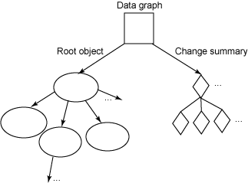
DataObject
Composed of properties
Single and many-valued properties
Properties accessed & modified by name, offset, Property, XPath
Can contain other DataObjects as properties
Reverse link to containing DataGraph

Slide 40
Generated Data API Example
public interface Person {
String getName();
void setName(String name);
int getPostalCode();
void setPostalCode(int code);
}
Person p = (Person) dataFactory.create(Person);
p.setName("John");
p.setPostalCode(94133);
System.out.println(p.getName());

Slide 41
Dynamic Data API Example
<complexType name="Person">
<attribute name="name" type="string"/>
<attribute name="postalCode" type="int"/>
</complexType>
DataObject o = dataFactory.create(tns, "Person");
o.set("name", "John");
o.set("postalCode", 94133);
System.out.println(o.get("name"));

Slide 42
DataObject
get(Property)
set(Property)
Properties by String, int, Property, XPath
  get("address")
  get(1)
  get(address)
  get("address/zip")
isSet(Property)
unset(Property)
create(Property)
delete()

Slide 43
DataObject - Typed Accessors
getXXX(property). XXX is
  primitives: int, float, boolean, byte[], …
  String
  BigDecimal, BigInteger
  Date
  List for multi-valued properties
  converts between primitives and Objects
  converts between data types
    getInt("width") of 5.123 returns 5

Slide 44
Update SDOs
DataObject customer1 = customers.getDataObject("customer[1]");
customer1.setString("firstName", "Kevin");
ChangeSummary updated to mark object changed with old value of "Adam"
<customers xmlns="http://customers.com">
<customer SN="1" firstName="Kevin" />
<customer SN="2" firstName="Baker" />
</customers>

Slide 45
Example 1 – Accessing DataObjects
// Get an employee using an SDO xpath expression
// starting from the company
DataObject employee =
company.getDataObject("departments[number=123]/employees[SN=0002]");
// Or, an SDO xpath expression can find the employee
// based on positions in lists:
DataObject employee = company.getDataObject("departments.0/employees.1");
// Or, use the API to go step by step to find the employee
// Get the list of departments starting from the company
List departments = company.getList("departments");
// Get the department at index 0 on the list
DataObject department = (DataObject) departments.get(0);
// Get the list of employees for the department
List employees = department.getList("employees");
// Get the employee at index 1 on the list
DataObject employeeFromList = (DataObject) employees.get(1);

Slide 46
Example 2 – Updating DataObjects
// Set the company name
company.setString("name", "ACME");
// create a new employee
DataObject newEmployee = department.createDataObject("employees");
newEmployee.set("name", "Al Smith");
newEmployee.set("SN", "0004");
newEmployee.setBoolean("manager", true);
// Set employeeOfTheMonth to be the new employee
company.set("employeeOfTheMonth", newEmployee);
<company name="ACME" employeeOfTheMonth="0004">
<departments name="Advanced Technologies" location="NY" number="123">
<employees name="John Jones" SN="0001"/>
<employees name="Jane Doe" SN="0003"/>
<employees name="Al Smith" SN="0004" manager="true"/>
</departments>
</company>
PKU-IBM

Slide 47
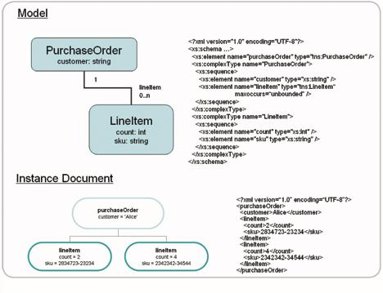
Instance and Model
Notes:
SDO offers a convenient way to work with XML documents. SDO implementations provide helpers to populate a data graph from both XML documents and relational databases and to read SDO metadata from an XML Schema Definition (XSD). Data objects can be serialized to XML and the metadata can be serialized to an XSD file

Slide 48
XML/XSD integration
Direct correspondence between XML and DataObjects
XMLHelper
  Load and save DataObjects to XML streams
XSD mapping to and from SDO
XSDHelper
  Get XML specific information - isElement, isMixed, local name, appinfo
  Define Types and Properties from XSDs
    Annotations or XSLT for mapping control
  Generate XSDs from Types and Properties

Slide 49
Apache Tuscany SDO
SDO for Java (sub)project goals:
1. 100% implementation of 2.01 Specification
2. Identify issues with SDO spec and provide feedback for future versions (e.g., 2.1 and 3.0)

Slide 50
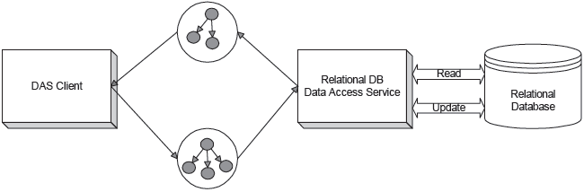
Apache Tuscany DAS
SDO 2.1 Specification -DAS definition:
  “Components that can populate data graphs from data sources and commit changes to datagraphsback to the data source are called Data Access Services”
Data Access Services (DAS) provides two fundamental capabilities:
  Results of a data source query returned as a graph of Data Objects
  Graph modifications reflected back to data source as a series of Creates/Updates/Deletes

Slide 51
DAS Overview
DAS provides a simple and intuitive interface
  Based on Command pattern
  Most read interactions consist of acquiring a command and then executing it
  Most write interactions consist of providing a modified graph (with change summary) to a DAS instance

Slide 52
Simplest Read
// create a DAS instance with a given database connection
DAS das= DAS.FACTORY.createDAS(getConnection());
// create a Command instance using a given SQL query statement
Command readCustomer= das.createCommand("select* from CUSTOMER where ID = 1");
// execute the query, returning the root of the data graph representing the result set
DataObject root = readCustomer.executeQuery();
// obtain the first (and only) CUSTOMER data object from the root data object
DataObject cust= root.getDataObject("CUSTOMER[1]");

Slide 53
Write
Pushing changes back to the DB can be equally straightforward (continuing previous example)
  cust.setString(“LASTNAME”, “Williams”);
  das.applyChanges(root);
Note the lack of configuration (no side file) for these two examples
  Convention over configuration
    SDO properties named “X” will map to column “X” on the data source repository
    SDO properties named “ID” will be considered Primary Keys

Slide 54
Config File
Configuration file can be used to organize related sets of commands and other configurable items
Previous examples employing a config file
  DAS das = DAS.FACTORY.createDAS(getConfig("customerConfig.xml"), getConnection());
  Command read = das.getCommand("read customer");
  DataObject root = read.executeQuery();
  DataObject cust = root.getDataObject("CUSTOMER[1]");
  …
  cust.setString ("LASTNAME", "Williams");
  das.applyChanges(root);
SQL has been moved to a side-file file
  <Config xmlns="http:///org.apache.tuscany.das.rdb/config.xsd">
  <Command name="read customer" SQL="select * from CUSTOMER where ID = 10021" kind="Select“ />
  </Config>

Slide 55
Reference
http://osoa.org/display/Main/SDO%20Resources
http://tuscany.apache.org/sdo-overview.html
http://tuscany.apache.org/das-overview.html

